Slide 1
CS250 Lecture 41 – Advanced topics
2017.12.01
We have not succeeded in answering all our problems. The answers we have found only serve to raise a whole set of new questions. In some ways we feel we are as confused as ever, but we believe we are confused on a higher level and about more important things.
– Earl C. Kelley, Wayne University

Slide 2
Two categories of multiprocessors
Asymmetric
Collection of different processors
Can be optimized for specific tasks
Symmetric
Set of N identical processors
Most popular MIMD design: today’s cluster supercomputers
Historic examples: Illiac IV (from U. Illinois, installed at NASA Ames), Encore Corp. Multimax, Sequent Corp. Balance 8000

Slide 3
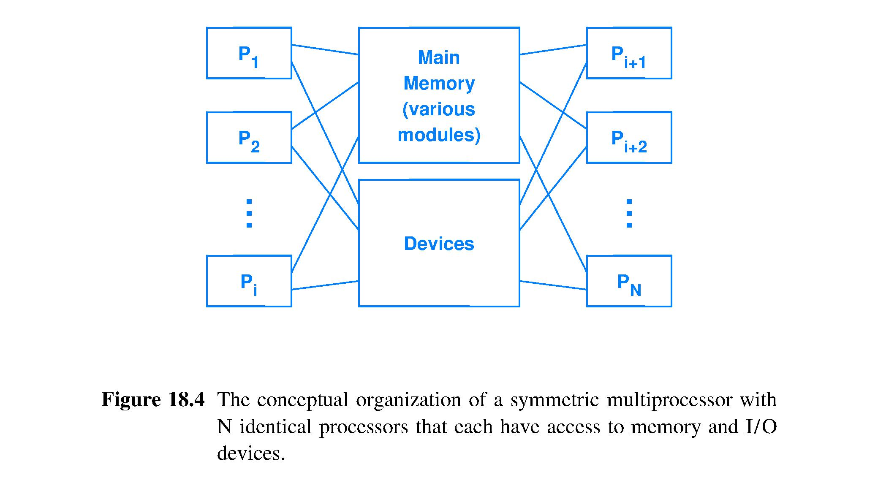
Symmetric multiprocessor (SMP) diagram
Major problem with SMP: contention for memory and I/O devices

Slide 4
Sequent Computer Systems, Inc.
Founded 1983; a pioneer in
High-performance symmetric multiprocessing (SMP) open systems
Multiprocessor cache management and interrupt handling and synchronization software (read-copy-update)
18 founders: 17 Intel, 1 DEC; one recent Purdue grad
RIACS purchased serial #5 Balance 8000 on March 29, 1985 to replace VAX 11/780

Slide 5
Balance 8000 specs
10 MHz National Semiconductor NS32032 processors, each with a small, off-chip, write-through cache connected to a common memory to form a shared memory system
NS32032 was the first 32-bit microprocessor, but had only 24-bit memory addresses
VAX-like CISC instruction set
DYNIX O/S gives new process to an idle processor when possible
Notes:
Who needs more than 640KBytes?

Slide 6
Multiprocessor overhead
More processors is not always a clear win
Overhead sources may increase non-linearly with increasing number of processors
Time devoted to inter-processor communication (unneeded for a program on a SISD computer)
Coordination needs: mutual exclusion, barriers
Contention for resources
All overhead sources may become bottlenecks limiting speedup of programs (algorithms) on multiprocessor machines

Slide 7
Multiprocessor coordination: Barriers
In code, a barrier means that all processes must stop and may not proceed until all processes reach the barrier (can also use with threads)
Barriers are used to synchronize computation
Naive barrier implementation
Establish a Stop/Pass barrier state and arrivalCount of processes at barrier.
First process to arrive sets barrier to Stop and arrivalCount = 1.
arrivalCount++ for each new arrival until maxCount which sets barrier to Pass and arrivalCount = 0; then
all processes proceed with execution beyond the barrier.
Controlling a parallel computer is not quite this easy

Slide 8
Barrier issues: MIMD deadlock
A barrier, used more than once, changes from Stop to Pass
Let one processor race ahead to the same barrier in the code before the last processor has left the barrier [Events look like the following]
Count will never reach maxCount
MIMD computer is now deadlocked
No further progress can be made on the computation
MIMD Processors
0 1 2 3 … N-1
Count = N = maxCount,
so Pass==True and Count = 0
First arrival, so Stop==True and Count = 1
Increment Count for each new arrival, but

Slide 9
Barrier issues: Massive MIMD systems
Scalability problem
Large number of processors means high frequency of attempts to read Stop/Pass state (stopped processors want to Go, GO, GO!)
Access bottleneck to barrier state reduces scalability to larger number of processors and/or processes

Slide 10
Barrier issues solutions
Sense-reversing barrier
Encode barrier state as 0==Stop, 1==Pass for first instance
Next instance encode 1==Stop, 0==Pass; continue alternating as many times as this barrier is used
Avoids trapping a slow-starting processor/process
MIMD Processors
0 1 2 3 … N-1
1st instance has State==0 (means Stop) until
Count = N = maxCount, then
State==1 (means Pass) and Count = 0
2nd instance encoded as 1==Stop, 0==Pass
First arrival sees state==1 and Stops
Any processor not yet started from 1st instance
can still pass that barrier and will stop at 2nd

Slide 11
Barrier issues solutions
Relieve contention for access to Stop/Pass memory location by implementing a hardware Combining Tree for synchronization
Tree structure combines requests for access
Parent sends one merged request up the tree from its waiting children processors/processes
Ultimately, one request is emitted by the tree root; the root node makes one access to the Stop/Pass memory location on behalf of all tree nodes
When barrier state changes to pass, the Pass signal is sent down and broadcast to all tree nodes reaching each child

Slide 12
Multiprocessor contention for resources
Multiple processors means multiple, simultaneous use of caches, memory, I/O
E.g., bus makes N-1 processors wait while 1 processor has access
This is structural hazards, writ large

Slide 13
Multiprocessor memory coherence
Consider two processors, P1 and P2, each with own write-back L1 cache and shared main memory. Value x is in neither cache.
P1 reads x, has a cache miss, and then stores a new x value into its write-back cache
Later, P2 reads x, has a cache miss, but needs to satisfy this miss from P1 cache, not main memory
This is an example of the cache coherence problem for multiprocessors
Difficult problem to solve as number or processors scales

Slide 15
Not an atomic
operation
unless a lock
is used because
Processor 2
can read x
after the
increment occurs
yet receive the
pre-increment
value
Notes:
Same problem as needing to not read an argument from the register file if that argument is still in the pipeline and only on its way to the register file.

Slide 16
Prevent simultaneous,
uncoordinated WRITE access
Simultaneous READ-only access
is always fine

Slide 17
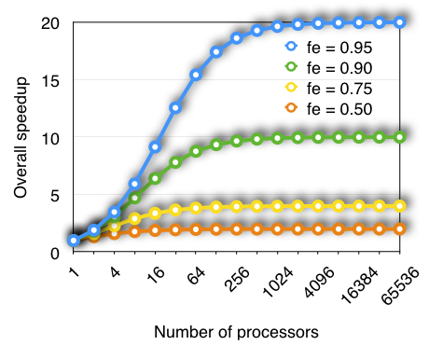
Amdahl’s Law and parallelism
If speedup from adding processors grows linearly and f_{e} remains constant:

Slide 23
MISD example – data pipelining
A data pipeline can dramatically increase performance
Example – internet router processing packets
Assume that router
Processes one packet at a time
Performs six functions on each packet

Slide 27
Multiprocessors by degree of coupling
Tightly coupled microprocessor
Multiple processors in a single computer
Switching fabric used to interconnect
Typically, one operating system
E.g., supercomputers in MATH
Loosely coupled microprocessor
Multiple, independent computers
Computer networks used to interconnect
Each computer runs operating system of choice
Know as distributed computing

Slide 28
Grid computing
A form of loosely-coupled distributed computing
Use otherwise idle time of many computers on the internet to achieve high throughput in solving small portions of a very large problem; maybe a future for your Pi
Use redundancy to identify and screen out errors and cheaters
Have two computers solve a given small problem
If computers disagree, send same small problem to a third computer
Valuable for large computations that can attract volunteers
Many such projects use the BOINC software infrastructure
U.C. Berkeley Open Infrastructure for Network Computing
https://boinc.berkeley.edu
Millions of volunteered computers working on, for example,
Einstein@Home - search LIGO sensor data for evidence of neutron stars
IBM World Community Grid – support cancer, Zika, TB, Ebola, AIDS research
SETI@home – analyze radio telescope data in Search for Extraterrestrial Intelligence

Slide 29
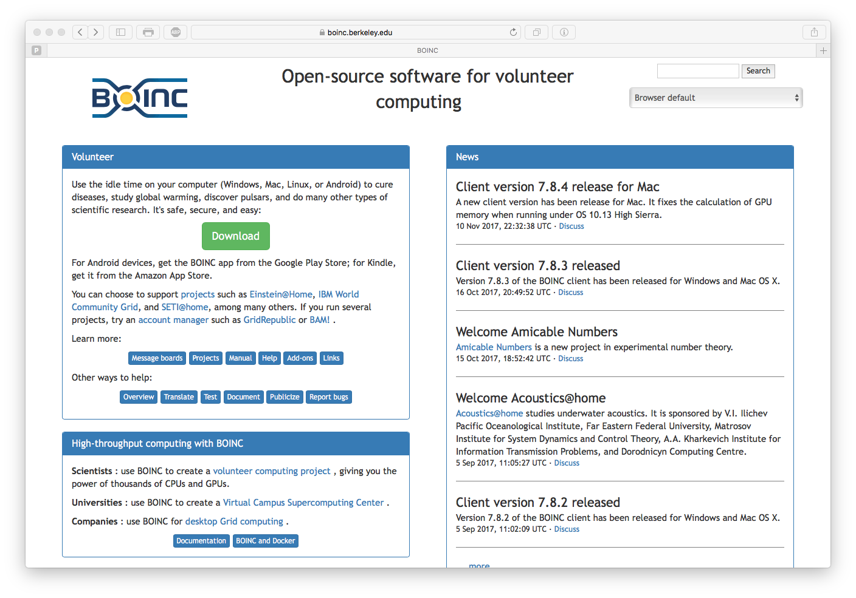
Grid computing example
Notes:
Berkeley Open Infrastructure for Network Computing (BOINC)

Slide 30
Summary
Parallelism is a fundamental technique for improving hardware performance
Flynn taxonomy is simple, useful
Multiprocessor architectures may be symmetric or asymmetric; explicit or implicit
Multiprocessor speedup is usually less than linear in the number of processors due to overhead of coordination

Slide 31
Summary (continued)
Programming multiprocessors is usually difficult
Programmer must divide overall task onto multiple processors
Locks needed for correct handling of shared writable data
Today’s fastest computers are MIMD clusters

Slide 32
Final exam information
Final exam covers
Textbook chapters 1 through 22
All lectures
All homeworks
All labs
Final exam format
50 multiple choice questions at 3 pts. each
Some emphasis on material since Midterm 2, yet, comprehensive coverage of the semester
Closed book, closed notes, no calculators

